Slide 1

PRESENTED BY -
AAMLEEN AHMED,
MOHD. SUFYAN AZAM
NETWORK SECURITY
VERIFICATION OF DRIVER’S LICENSE

Slide 2

INTRODUCTION
- RSA offers strong encryption that is resistant to brute-force attacks due to the difficulty of factoring large numbers.
- That is why RSA was used to encrypt/decrypt the messages send/receive from the RTO.
- RSA is used to create digital signatures, ensuring data integrity and authenticity. It is also widely used in various applications, including secure email, and online banking.
- In this mini-project, we completely implement an On-The-Go Verification of Driver’s License using an RTO that sends/receives messages in a secure way.

Slide 3
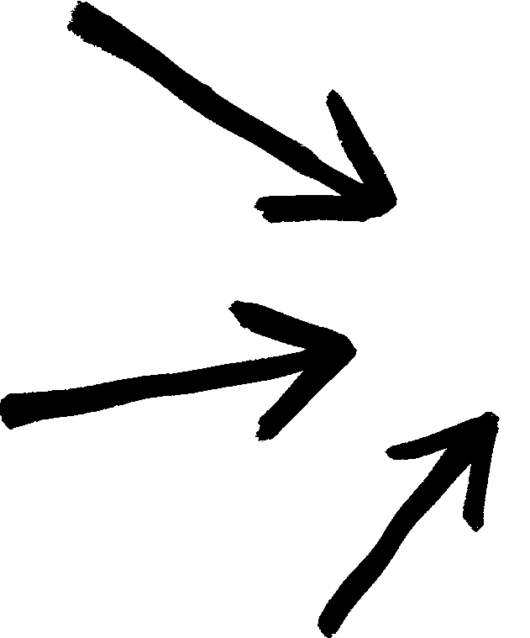

STRUCTURE OF CODEBASE
server.py
Central RTO
Client.py
Regional RTO
Regional RTO
Regional RTO

Slide 4
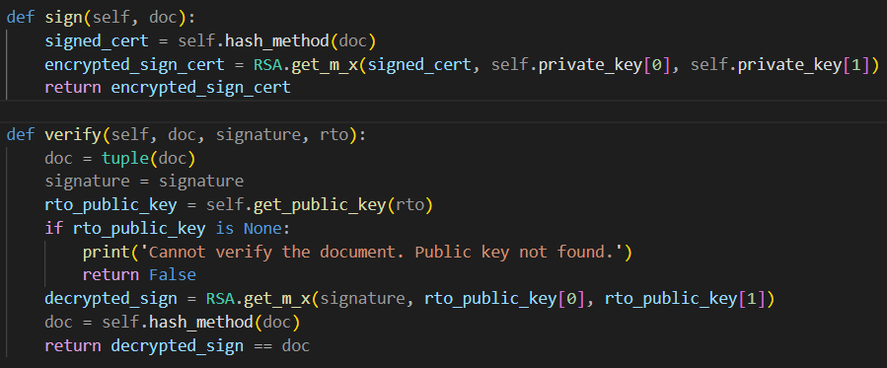
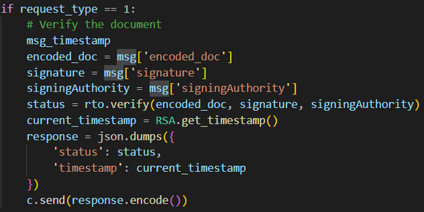
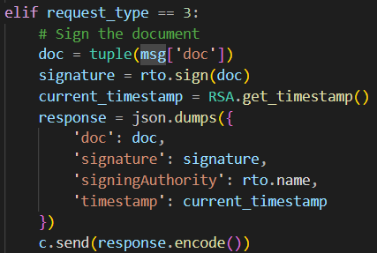
server.py
Proper Encryption using RSA is maintained throughout, and signature ID is generated using Hashing, for double security.
It handles 3 request types:
Issuing and Signing a new DL: In this, the server will take the issued DL Number and other details as a string and generate the sign hash value for it, and then encrypt it using its private key. This information is printed on DL QRs.
Verifying DL: It receives the encrypted and signed DL details along with the information about the signing authority. It will then decrypt the same using the public key of issuing authority.
Sign and Verify functions

Slide 5
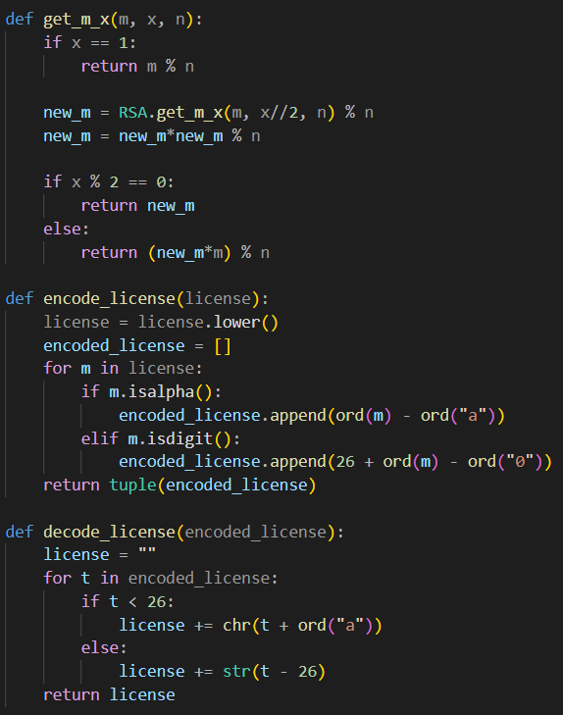
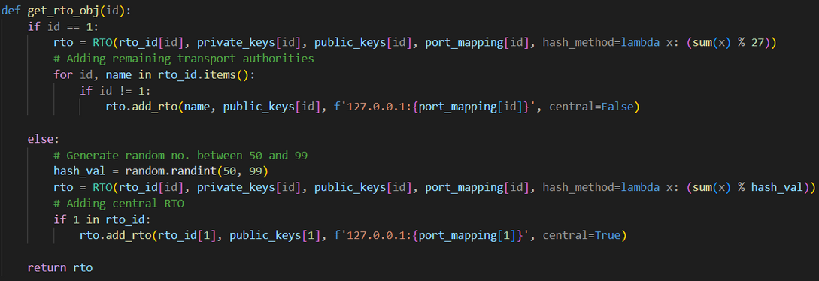
server.py & RSA verification
Creating Server Objects RTOs
RSA Encode Decode and generating keys

Slide 6
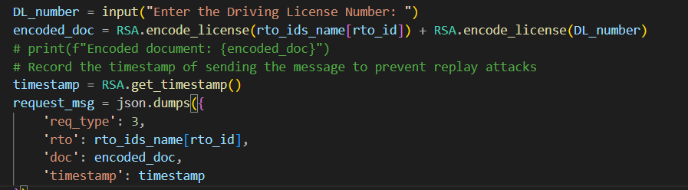
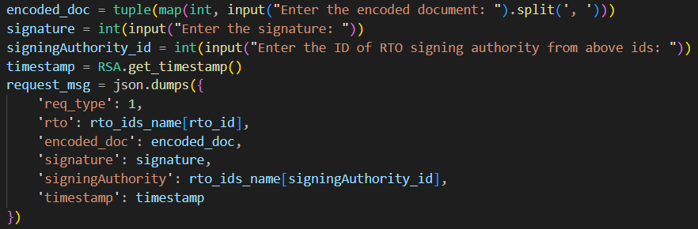
client.py
The client can perform 2 actions:
Getting a new DL signed and issued: In this, the client will send the DL information to generate the encrypted DL ID and also to get it signed by the authority.
Verifying a DL: The DL encrypted details will be read from the digital QR and will be sent to the local RTO for verification.
Replay attacks prevention using timestamp: The timestamps are engraved on the json messages before sending and then they are extracted accordingly. The received timestamp is compared against the current time to detect any significant gaps in between siggesting an attack.
Signing and Issuing new Dl
Verifying DL

Slide 7
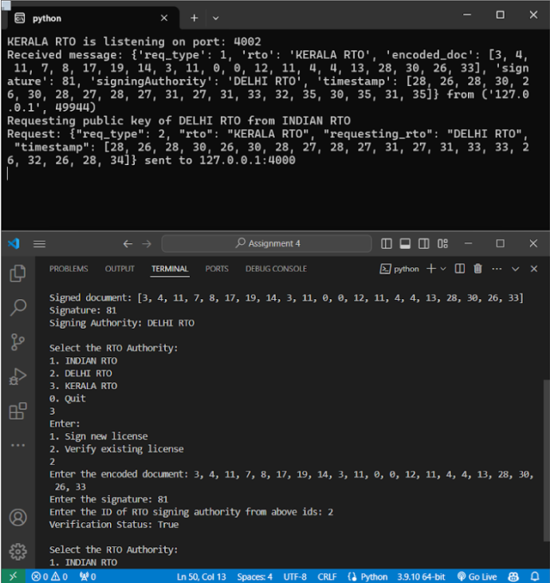
Features
We used RSA algorithm for secure communication between users and the Transport Authority.
To maintain integrity, we used a hash value on the license ID.
If an RTO does not posses the details of the requested license then it will pass on to the national authority and request the validity of the license from it.
Taken care of replay attacks by incorporating date time information on each encoded message sent between the RTO and the user.
Running the Application

Slide 8
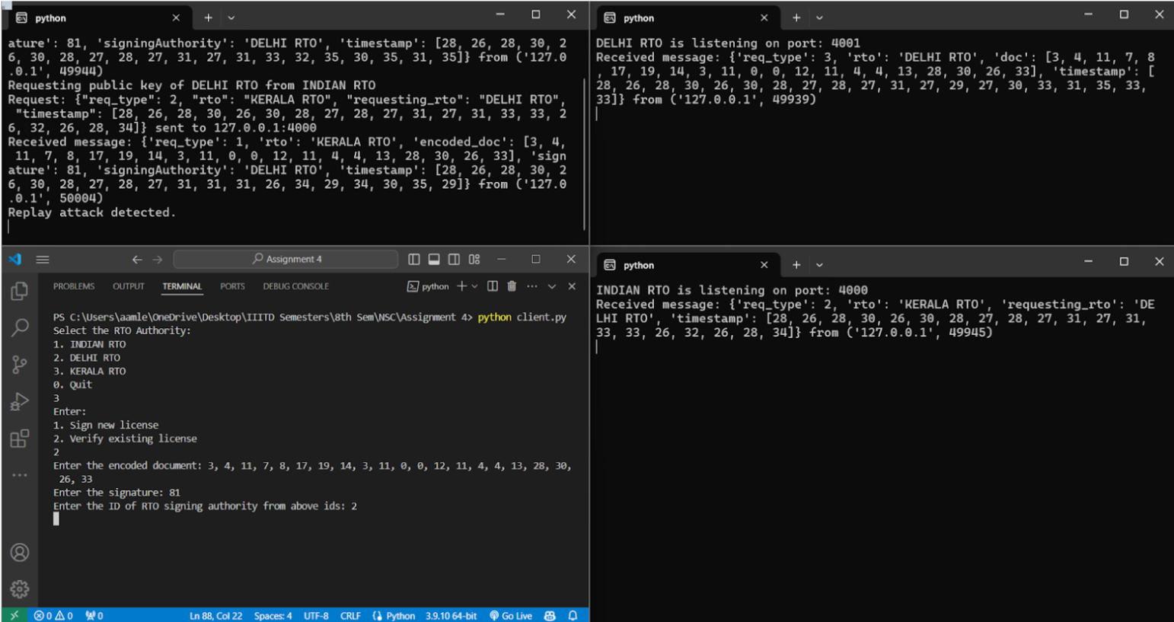
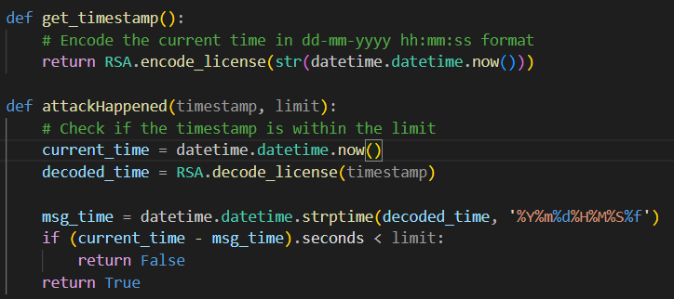
Bonus
The date time communication is important to prevent replay attacks.
The information is encoded using the RSA algorithm and then sent over a secure channel using socket programming.
Additionally a hash value is also sent of the original message so that the integrity of the received message can be verified.
If the difference between the date time sent and received is greater than a threshold then it will drop the packet as it indicates replay attacks.
Replay Attack Being Discarded

Slide 9
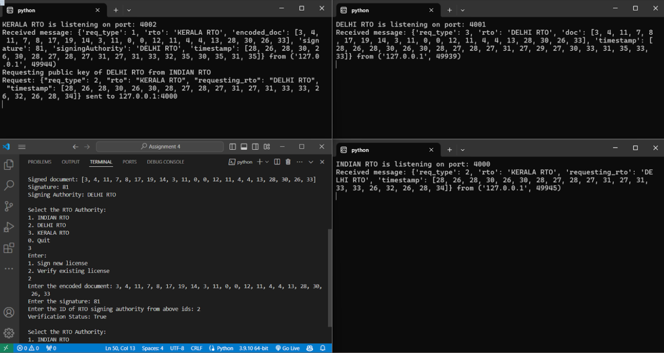
TESTING

Slide 10

PRESENTED BY
AAMLEEN AHMED (2020002)
MOHAMMAD SUFYAN AZAM (2020312)
THANK YOU VERY MUCH!
NETWORK SECURITY - PROJECT 3

